Slide 1

Qlikview for Beginners
View BI & Data Visualization with Qlikview course details at www.edureka.co/qlikview

Slide 2





What will you learn today?
Brief history of QlikView
Why QlikView as compare to other BI Tools
Career Opportunities with QlikView
Advantages of using QlikView
How companies are adopting QlikView
Hands On Example

Slide 3
Brief history of QlikView
Founded in Sweden in 1993 by Björn Berg and Staffan Gestrelius originally as a consultancy
Originally called “QuikView” as in “Quality, Understanding, Interaction, Knowledge”
Product was designed to mimic the way the brain works
First two versions were basically written in Excel using VLOOKUPs
Now has over 24,000 customers in 100 countries and employs over 1,000 people worldwide
Market cap: $2.5 billion

Slide 4
Why QlikView?
Patented in-memory technology
Faster BI solutions development
Complete suite for R&A (Integration -> Modeling -> Presentation)
Associative User Experience

Slide 5
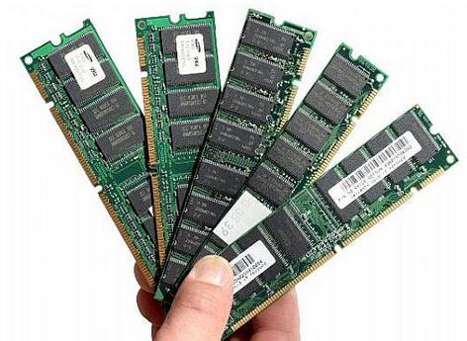

In-Memory Technology

Slide 6
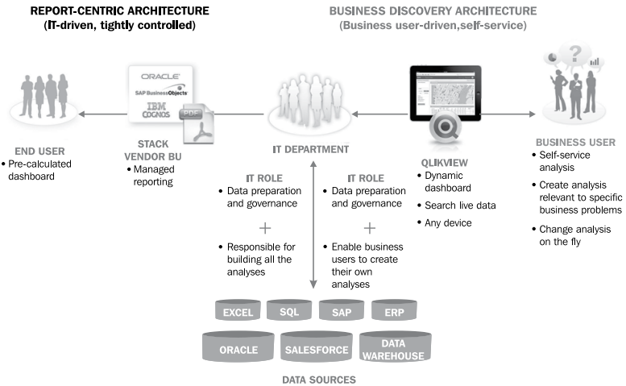
Faster BI Solutions Development

Slide 7
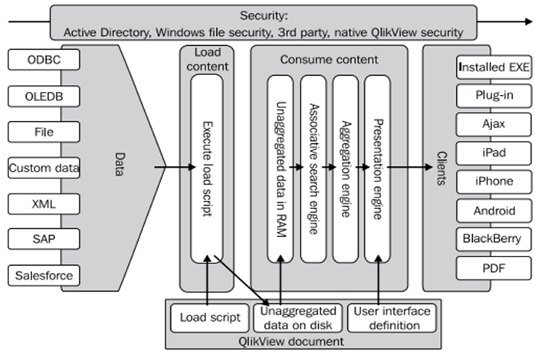
Complete suite for R&A
Integration
Modeling
Presentation

Slide 8
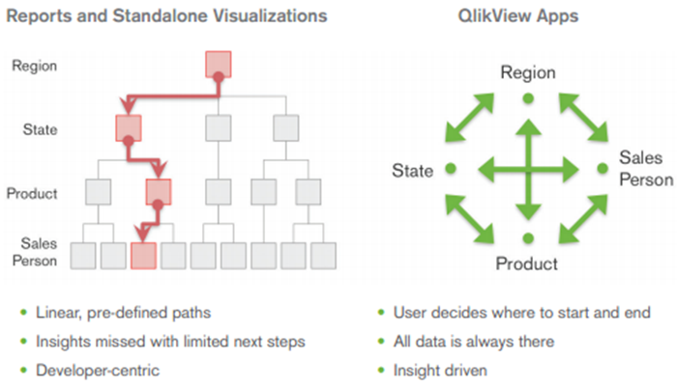
Associative user experience

Slide 9





Major Companies using Qlikview

Slide 10
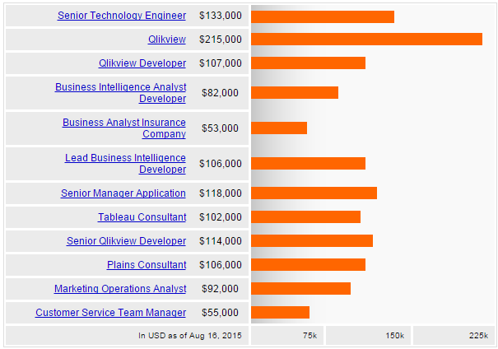
Salary Trends in India
Source: Indeed

Slide 11
Job Trends in India
Source: Naukri.com

Slide 12
Advantages of using QlikView
Down – Top approach of development instead of Top - Down approach of adoption
Analyst & Business Friendly approach of using QlikView
Faster Development & Change Management
Self Service BI for End Users
Minimal previous IT knowledge to start working on QlikView
Data Integration, ETL and Presentation in one tool
Efficient Multilayer application development

Slide 13
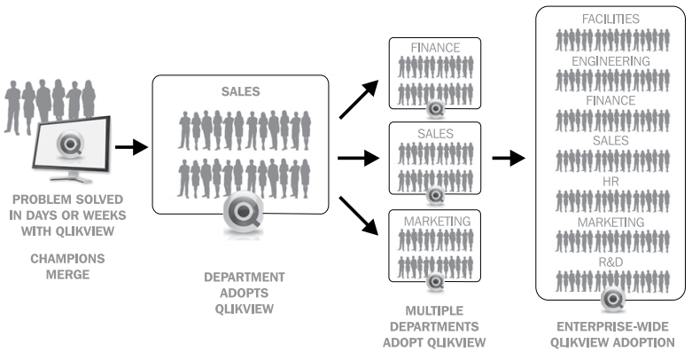
Ways company adopting QlikView

Slide 14


Demo
Selenium Suite – Selenium Grid
Selenium-Grid runs multiple tests at the same time against different machines running different browsers and operating systems
Node 1: IE on Windows
Node 2: Android
Node 3: Safari on Mac
Node 4: Firefox in Ubuntu

Slide 15

Certification
Get certified in BI & Data Visualization with Qlikview Course by Edureka
Go to www.edureka.co/qlikview
Batch starts from 7th November (Weekend)
Edureka's BI & Data Visualization with Qlikview course:
This course covers all the concepts of Qlikview tools like Data Interpretation, Designing, Modeling and then dives into advance features of Qlikview like Analyzying the data, Discovering the hidden data and generating attractive graphs and charts.
You will work on a real life Project, implementing data into image for Dashboard.
Online Live Courses: 24 hours
Assignments: 25 hours
Project: 20 hours
Lifetime Access + 24 X 7 Support

Slide 16
Survey
Your feedback is vital for us, be it a compliment, a suggestion or a complaint. It helps us to make your experience better!
Please spare few minutes to take the survey after the webinar.

Slide 17
Thank You …
Questions/Queries/Feedback
Recording and presentation will be made available to you within 24 hours

